Slide 1
RAPIDO RIDE PERFORMANCE
PRESENTED BY
YUVASRI D

Slide 2
INTRODUCTION
Rapido is a rapidly growing ride-sharing platform that generates a large volume of operational data every day, including ride details, revenue, service usage, and payment information. Analyzing this data is essential to understand ride demand patterns, service performance, revenue trends, and operational efficiency.
Power BI is a powerful business intelligence and data visualization tool that converts raw data into interactive dashboards and insightful reports. It enables users to monitor key performance indicators (KPIs), identify trends, and make data-driven business decisions efficiently.

Slide 3
PROBLEM STATEMENT
Rapido ride data is large and operationally complex, making it difficult to monitor ride performance, revenue trends, service efficiency, and cancellation behavior using traditional spreadsheet analysis methods.
Due to the absence of centralized analytics, management may struggle to make informed decisions regarding pricing strategy, service optimization, and performance improvement.
This project aims to address these challenges by developing a Rapido Riders Analytics Dashboard using Power BI .

Slide 4
BUSINESS PROBLEM
How is overall ride demand trending over time?
Which service types (Auto, Bike, Cab Economy, Parcel) are generating the highest revenue?
What is the current cancellation rate, and how is it impacting profitability?
Are there identifiable peak demand periods that require better driver allocation?
How efficient are rides in terms of duration, speed, and fare per KM?
Which routes contribute most to total revenue?
What payment methods do customers prefer, and how does it impact operations?

Slide 5
DATA OVERVIEW
services (Auto, Bike, Cab Economy, Parcel)
date
ride status
source & destination
duration
ride id
distance
ride charge
misc charge
total fare
payment method

Slide 6
TECHNOLOGY USED
Microsoft Excel – Data source (ride dataset)
Power BI Desktop – Dashboard creation
Power Query – Data cleaning & transformation
DAX (Data Analysis Expressions) – KPI and measure calculations
Power BI Visualizations – Charts, Cards, and Slicers for analysis

Slide 7
DATA PREPROCESSING
Changed data types (Date, Number, Text) correctly.
Removed duplicate records using ride_id.
Handled missing (null) values in fare, distance, and payment columns.
Standardized service names (Auto, Bike, Cab Economy, Parcel).
Trimmed unwanted spaces in text columns.
Converted and validated the date column format.
Created necessary calculated columns for analysis.

Slide 8

KEY METRICS AND KPI’S
Total Rides: Total number of rides completed during a specific period.
Total Revenue: Total income generated from all completed rides.
Completion Rate: Percentage of rides successfully completed out of total rides, indicating overall operational efficiency and service reliability.

Slide 9
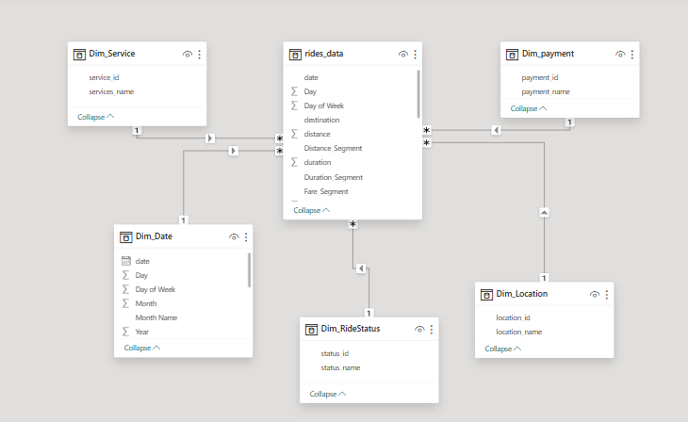
DATA MODELING- OVERVIEW

Slide 10
DAX MEASURES
Dax is called as Data Analytics Expression.
Dax is a formula language used in power BI.
To perform calculations and data analysis.
Measures :
Total Rides = COUNT('Rapido Riders'[ride_id])
Total Revenue = SUM('Rapido Riders'[total_fare])

Slide 11
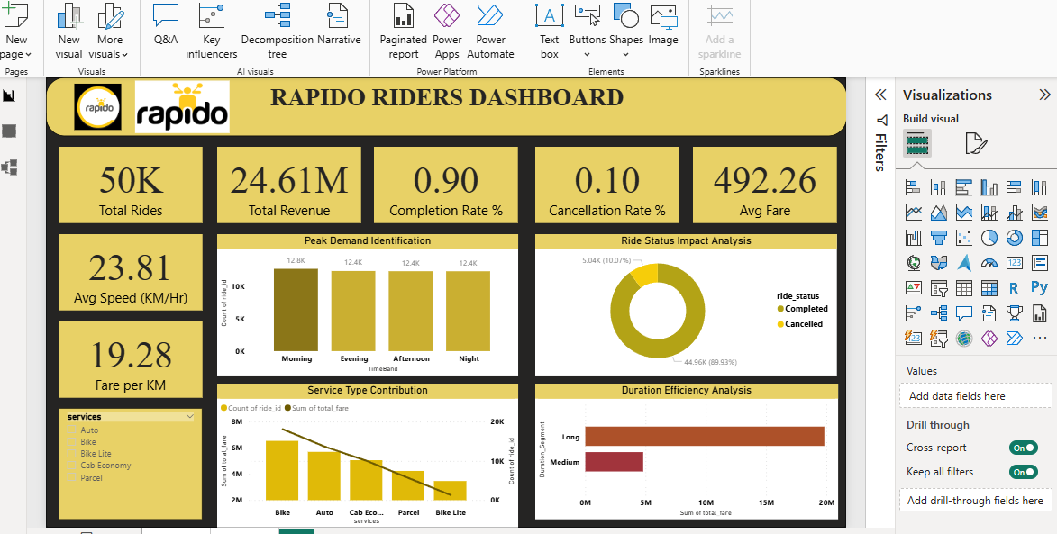
POWER BI DASHBOARD OVERVIEW

Slide 12
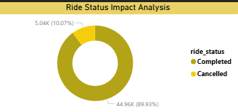
RIDE STATUS IMPACT ANALYSIS
Donut Chart: This chart is used to show the percentage distribution of ride status. It clearly represents the proportion of completed and cancelled rides.
Legend: Ride Status (Complete, Cancelled) Values: Total Number of Rides

Slide 13
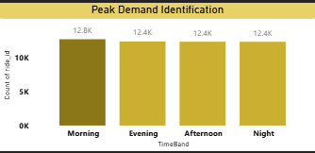
PEAK DEMAND IDENTIFICATION
Clustered Column Chart: This chart is used to compare ride demand across different time periods and identify peak demand hours.
X-Axis: Time Period (Morning, Afternoon, Evening, Night) Y-Axis: Total Number of Rides

Slide 14
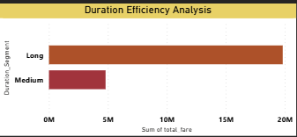
DURATION EFFICIENCY ANALYSIS
Bar Chart: This chart is used to analyze the average ride duration across different service types and evaluate operational efficiency.
Y-Axis: Services (Auto, Bike, Cab Economy, Parcel) X-Axis: Average Duration

Slide 15
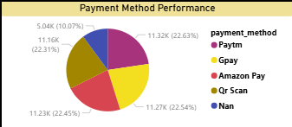
PAYMENT METHOD PERFORMANCE
Pie Chart: This chart is used to show the percentage distribution of rides across different payment methods. It helps analyze customer payment preferences.
Legend: Payment Method (Paytm, Gpay, Amazon Pay, QR Scan, etc.) Values: Total Number of Rides

Slide 16
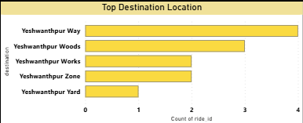
TOP DESTINATION LOCATION
Bar Chart: This chart is used to identify the top destination locations based on the number of rides. It helps understand high-demand drop-off areas.
Y-Axis: Destination Location (Yeshwanthpur Way, Yeshwanthpur Woods, etc.) X-Axis: Total Number of Rides

Slide 17
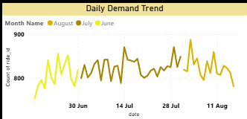
DAILY DEMAND TREND
Line Chart: This chart is used to analyze the daily ride demand trend over a period of time and identify fluctuations in ride volume.
X-Axis: Date Y-Axis: Total Number of Rides Legend: Month Name (June, July, August)

Slide 18
CONCLUSION
The Rapido Riders Dashboard in Power BI provides a comprehensive view of ride demand, revenue performance, service contribution, and operational efficiency.
The analysis shows a strong completion rate of 90%, indicating stable service performance, while the 10% cancellation rate highlights opportunities for operational improvement. Peak demand trends help in better driver allocation, and service-wise analysis identifies top-performing ride categories.
Payment method insights reveal customer preferences, and profitability analysis helps understand the balance between revenue and operational costs.
Overall, this dashboard enables data-driven decision-making, improves operational planning, and supports revenue optimization strategies for better business growth.

Slide 19
THANK YOU

